Slide 1
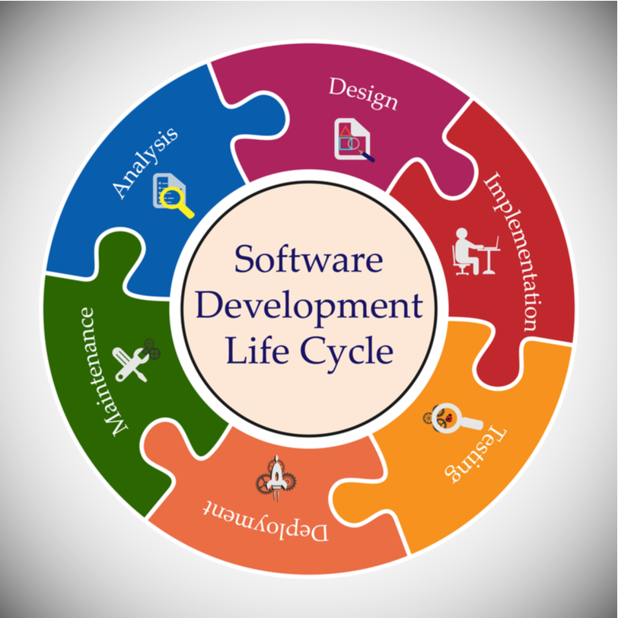
SDLC
Session - 1
Notes:
Hello everyone,
How are you
normally this class is planned to instructor Jamil but he has a flu
And I am the substitute teacher.
But no problem I hope we will have a nice class today.
Let me introduce my self:
I am Jacob
I am working remotely in a software company in marketing department.
And I am also working, we can say part time, in clarusway.

Slide 2
Software Development Life Cycle
SDLC
Notes:
Ok, today's lesson is SDLC, the Software Development Life Cycle.
This topic is mostly theoric and has too many definitions.
But you dont need to summirese any of them.
just get the knowledge about SDLC.
When you search on google about SDLC, you can see that there are too many resources.
However, instead of giving each subject here, I will try to explain the basic issues to you.
I plan to show you the general picture by repeating it and highlighting the important parts. OK?

Slide 3
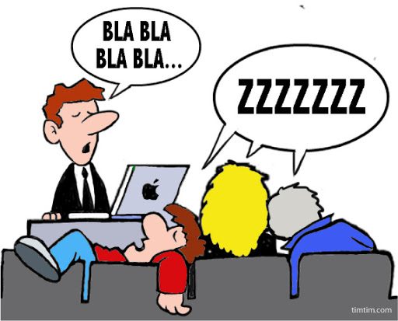
Notes:
so this is the wake up service:
As I said, this topic will cover a somewhat static subject with some definitions based on theory. In order not to get bored, I will try to take the lesson with your contributions as much as possible.
let me measure your attention and knowledge first.
Forget about software and IT.
Think that you are the manager of a table company. A customer visited you and said I want a table.
At the very beginning what would your first reaction be?
Your customer wants a table and you have to plan the production process of this table?
What do you first?
(understand the problem - What will be this table for?
a Dining table or a study table? How many people can sit it at the same time? 2-4-8 people? What is it made of? wooden or plastic maybe
So you begin to ask questions. Because you need to know the requirements.
- What are the requirements)
second step?
According to this requirements you have to design the suitable table.
Third step is production, manufacturing the designated table.
After production, you have to check the quality of your product.
and then you can deliver the table to the customer.
But is it finished?
If you are a good company You must also take care of the product.
Here comes the maintanance.
I made this analogy to make it simple to understand the software product management.
Now you will see It is nearly the same in SDLC.

Slide 4
BEFORE (in-class session)
What do you know about SDLC.
(Please write shortly on PEAR DECK slide)
Notes:
So lets begin with “What is sdlc”?
Now I would like you to write down on Peardeck whatever you have in your mind about SDLC.
Please don't think that you write wrong, let's write what comes to your mind when you think of SDLC.
Please be comfortable and briefly summarize what you know.
My aim here is only to help you compare your level of knowledge before and after the lesson.
Because you will be addressed with the same question at the end of the lesson.
my friends, thank you for your answers.
If we explain it with a single sentence in its shortest form,
we can say that “SDLC is a project management method applied for software development".
🍐 This is a Pear Deck Text Slide
🍐 To edit the type of question, go back to the "Ask Students a Question" in the Pear Deck sidebar.

Slide 5
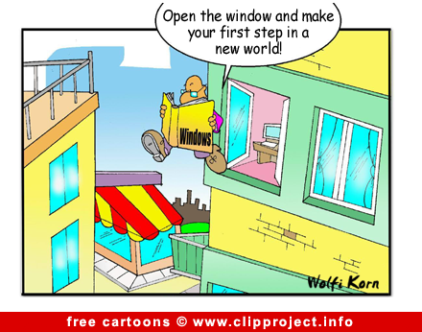
Notes:
Why is the topic of SDLC important,
I think many of you starts in this new field, software development here.
With topics such as SDLC, Agile, Scrum, Jira, that you will see in this cohort in ITF,
we will explain, the processes you will follow in your future work,
your daily working style,
how you will interact with your other teammates.
You will be a team member and you have to know the team play.
Dear friends, we want you to step into a new world in the field of IT by opening a different window to you with our lessons.
(but please watch your steps.)

Slide 6
Table of Contents
What is SDLC ?
Phases of SDLC
SDLC Models
Waterfall Model
* New approaches (agile and devops) and their implementations (Jira) will be explained later as separate lessons.
Notes:
You see the topics we are gonna discuss on the screen.
Today; We will enter with the subject of what is SDLC
Then we are gonna see the phases of SDLC.
We will touch on SDLC models that develop in the light of different perspectives and innovations.
Under this SDLC title, we will only see the traditional model, which we call the waterfall model.

Slide 7
What is SDLC ?
1
Notes:
First, let's briefly explain SDLC in general terms.

Slide 8
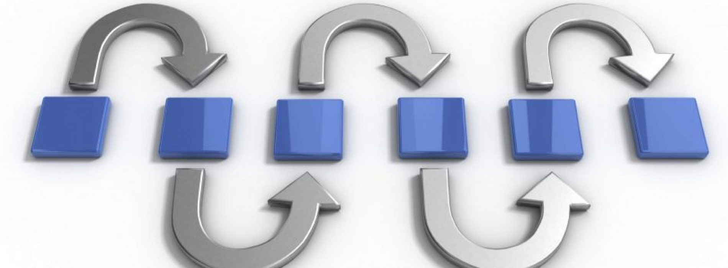

What is SDLC
Notes:
SDLC is the name given to the process to be followed for a software project.
As we said at the beginning,
the software development life cycle is a path to be followed while developing a software.
In other words, it is a structured way to create and develop software.
I like this definition most, among others.
SDLC is a structured way to create and develop software.
(copy and paste to classchat)
Actually a software is a product and like all other products a software has a product management way.
In IT world this way is called SDLC.
Why is it so important to follow a certain path in this way?
Q: May I take your opinions ? Lets discuss this: Why is it so important
You can write the answers in the Class chat.
Thanks for your answers, let me summarise them;
1.First of all, it allows us to make planning,
timing
and cost estimation
2. we can easily controll the process of the project.
3. So It makes the development process more organized. Because this is a team work, the team must be well organized.
Here comes the next explanation I like secondly most :)
The main purpose of SDLC is to produce software
with the highest quality
and lowest cost
in the shortest time.

Slide 9
What is SDLC
SDLC
Software Development Life Cycle.
Systematic process to be followed for a software project.
Structured way to create and develop software.
Notes:
It is a step-by-step procedure that must be followed to design and develop a high quality product.
It explains the stages of the software development lifecycle, how to develop and maintain software.
Systematic process to be followed for a software project.
Structured way to create and develop software.

Slide 10
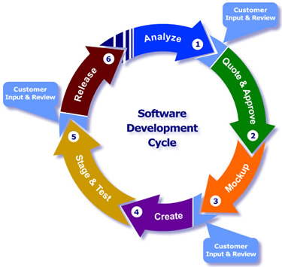
What is SDLC
Notes:
There are various phases within SDLC, and each phase has its own different process and activity. This helps the development team to design, create and deliver a high-quality product.
The software development process consists of stages based on timing and divided into content.
In this way, the software is developed in a planned way.

Slide 11

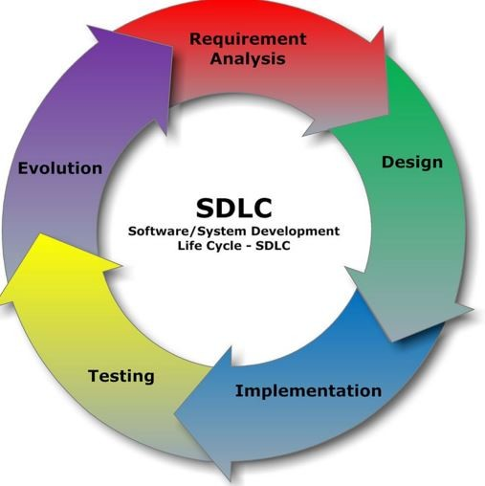
What is SDLC
Notes:
Now, when we look at a software development process in general, you can see a structure like this.
It starts from analysis, continues until design, implementation, testing, development and updating, so does it stop here? no
As you can see in the slide, SDLC is in the form of a cycle, the Process continues one after the other.
Well, if I ask a question like this:
Q according to you Why do you think such a process was shown as a loop?
You can write the answers in the Class chat.
(answer is in next slide)

Slide 12
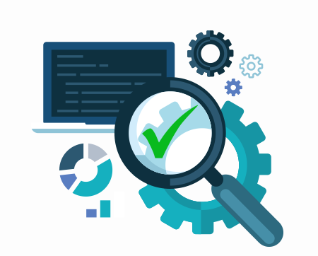
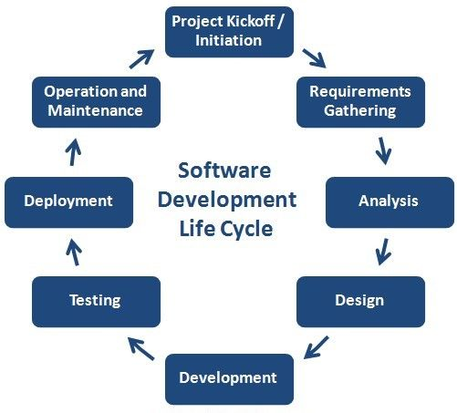

What is SDLC
V1.02.03
Notes:
thanks for your answers.
A For example the softwareIt is not a product that was made once 20 years ago and there is no need to do anything again! It is not a product we can call friends.
The software must be updated and renewed in the light of changing needs or technologies.
Or bugs may occur by time during use. These may need to be fixed. We often call them patches. For example, if those of you who play games on the computer know very well.
Is there any one who plays Football manager?
At the beginning of the football season new game is released and called football manager 2021.v1
There are sometimes some problems occur in the game for example training programme is not really works. So the developers fixes it than a new release is published with a name FM 2021.v2.
After this at the at the half of season new transfers are made. So a new patch is published for the new transfers so this is called for example FM 2021.v2.02
We can call this (major version - intermediate version - correction (patch)).
bottom line; In other words, changes and improvements may have to be made in software development both in the development phase and after it becomes production. As a result, different versions of the Software may appear.
so shortly we can say again, Since user needs and product errors arise from time to time,
it becomes a cycle in which reversals are made,
problems are solved with repetitions or new features are added.
Thanks to these cycles, the development of the software proceeds in a more comfortable and planned manner.
PLANIN ONEMİ

Slide 13
Notes:
Before starting to SDLC phases I want to take your opinions.
I just highlighted “High quality software”.
Q What comes to your mind when I tell you high quality software?
A customer came and asked for an application for his company.
What do we need to call the software you make for this customer “high quality”?
You can write on the class chat
A
-good design,
-functionality,
-suitability and redundancy of features,
-good performance
-Software suitable for use by the end user (user does not like or cannot use a bad interface)
perfect, all understood I think

Slide 14
Phases of SDLC
2
Notes:
We continue, my friends,
Now It's time to see what stages SDLC has and what is being done in those stages.
Actually Each development process, has certain stages.
You can apply this to any product on the market …
Sometimes SDLC is called System Development Life Cycle.
You can apply it to any project.

Slide 15
Phases of SDLC
How many phases does SDLC have?
Notes:
Before moving on to the phases, please write down on the PearDeck how many stages are in SDLC.
You can also mark more than one option in this question.
Good, there is intensity at 6 and 7.
I lock the answers for the last 10 seconds.
We will see the answers in the following slides. Not now, it is a secret :)
🍐 This is a Pear Deck Multiple Choice Slide. Your current options are: A: 4, B: 5, C: 6, D: 7, E: 8, F: All,
🍐 To edit the type of question or choices, go back to the "Ask Students a Question" in the Pear Deck sidebar.

Slide 16
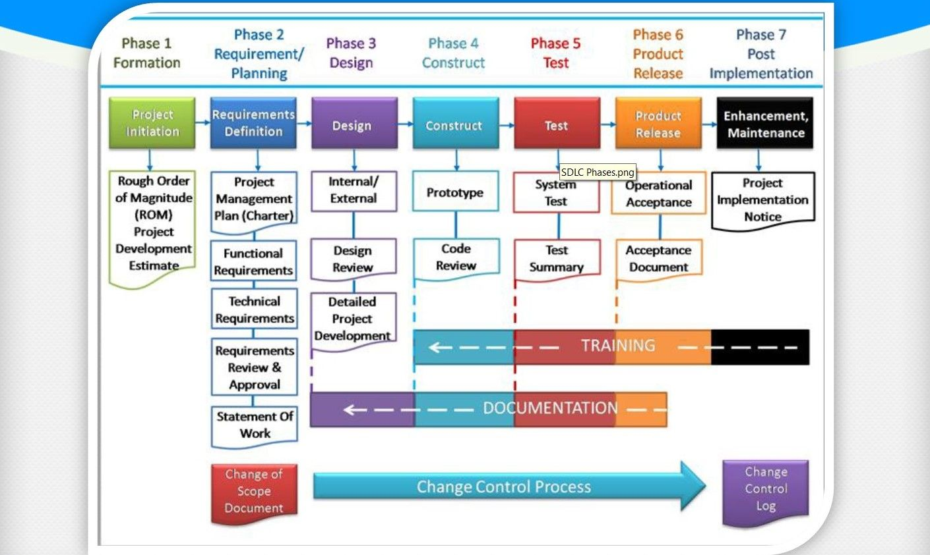
What is SDLC
Notes:
SDLC, which produces intermediate products to check whether they work according to customer requirements, has different stages and each stage has different processes and activities.
There are various phases within SDLC.
Each phase has its own different process and activity.
This helps the development team to design, create and deliver a high-quality product.

Slide 17
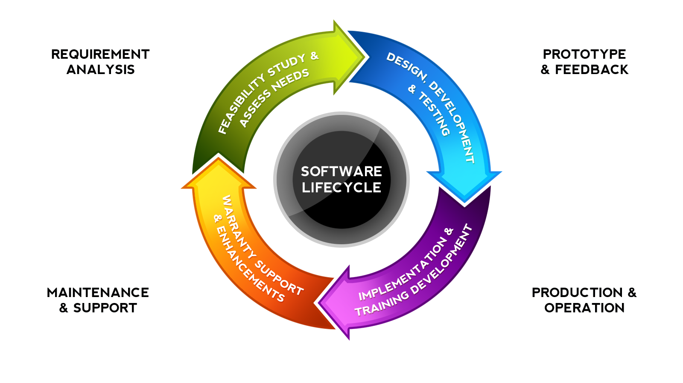
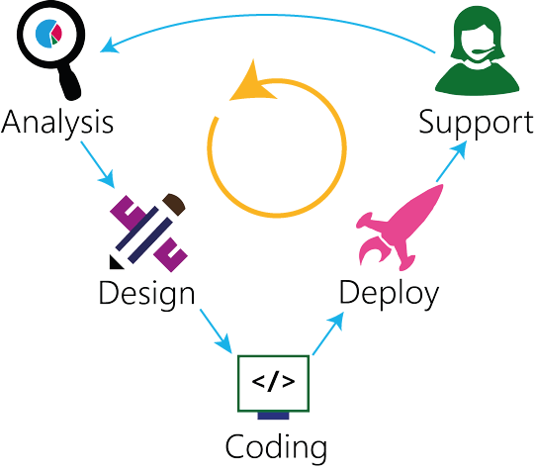
Phases of SDLC
Notes:
Now here comes the answer to our peardeck question;
We asked how many steps and stages SDLC consists of.
If you google it for SDLC
You can see that its phases are stated in different numbers in different sources.
It is possible to see that, it is usually staged from 4 to 8, and there are even those that write 10.
However, it is intensely specified as 6 stages mostly in sources for SDLC.
So we will also specify 6 stages because it is most common acceptance.

Slide 18
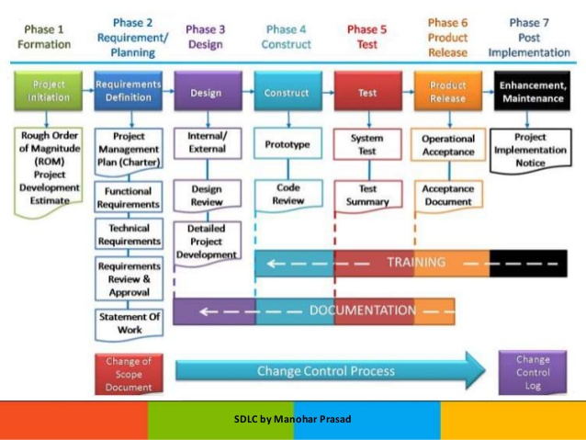
Phases of SDLC
Notes:
all phases are formed with different groupings of the same activities in a general framework.
Therefore, do not be confused by more or less stages that you will encounter in different sources.
for instance; while some get the analysis phase as a single phase, some get it as two separate phases.
Or they gave its name differently.
So do not be confused by the different phases you can see in different sources on the open sources.
Even if it is shown in all 4 stages, be sure the activities carried out in the process are almost the same, even if it is shown in 8 stages.
(code review - technical issue a senior team, makes comments)

Slide 19
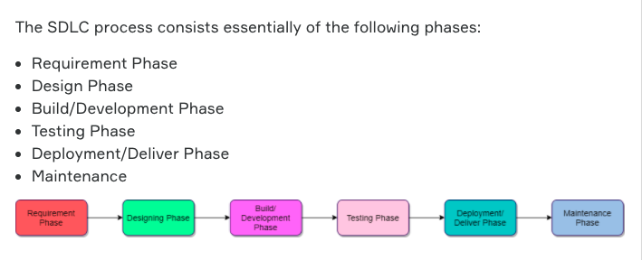
Phases of SDLC
Notes:
In our lesson, we will see the phases in 6 stages in accordance with the preclass materials. These are;
Requirement Phase
Design Phase
Build / Development Phase
Testing Phase
Deployment / Deliver Phase
Maintenance (maintenance phase)

Slide 20
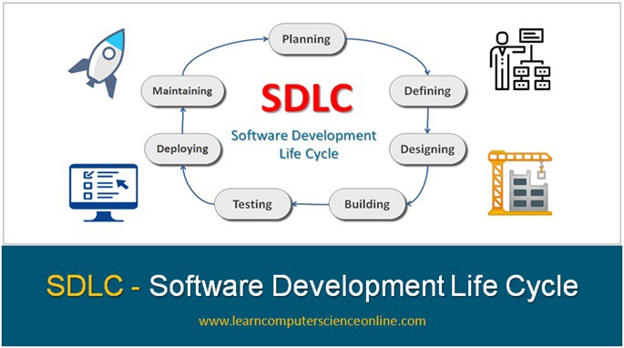
Phases of SDLC
Requirement Analysis
Design
Build/
Development
Testing
Install
Deploy
Maintenance
Notes:
Before going into the details, let’s summarize the stages;
The first phase is the definition of the requirements.
This is followed by the design phase.
Afterwards the coding of the product comes with development phase until the software is ready for testing.
The tested product is delivered to the end user, customer.
However, the process doesn't end there. Because the maintenance phase, in other words supporting starts after the product is deployed.
After all, each step is the basis for the next step, and this cycle continues until the software has completed its life.

Slide 21

Phases of SDLC
What is the most critical phase?
Notes:
Yes, I have a short question before continuing. Q What is the most critical step in SDLC? just guess it
Please answer the question on Pear Deck.
Requirement Phase, right, Why?
A At this stage, there is the answer to exactly what the customer wants.
An unsuitable input here causes the output to be incorrect.
So it means you are doing the wrong thing from the beginning.
Maybe you are doing the best app ever made but if it is not what customer needs it is no good.
So you should know the destination point, right?
🍐 This is a Pear Deck Multiple Choice Slide. Your current options are: A: Testing Phase, B: Maintenance Phase, C: Requirement Phase,
🍐 To edit the type of question or choices, go back to the "Ask Students a Question" in the Pear Deck sidebar.

Slide 22
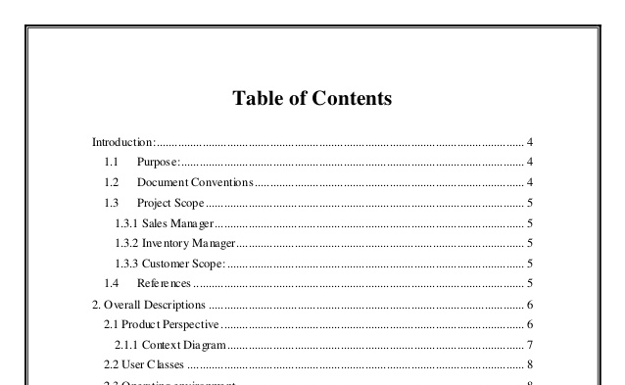

Phases of SDLC
What is the name of the document that consists of all necessary requirements to be designed?
Notes:
Q Another question is: What is the document that includes all system requirements and the basis for the design? Please give our answers on Pear Deck.
A Software Requirement Specification Document.
We will talk about SRS in detail while explaining the first stage.
🍐 This is a Pear Deck Multiple Choice Slide. Your current options are: A: Software Test Plan Document, B: Software Requirement Specification Document, C: Software Business Plan Document, D: Software Requirement and Design Specification Document,
🍐 To edit the type of question or choices, go back to the "Ask Students a Question" in the Pear Deck sidebar.

Slide 23

Requirements Phase
Notes:
Lets have a break here. We will continue with the first phase after break.
Hi again, Yes, we continue through the phases.
The Requirement phase is the first and most critical phase of SDLC for
both the development team and the project manager. This stage can be called the planning, definition or analysis stage.
At this stage, the customer determines the product or software-related requirements,
features,
expectations from the software and any other special requirements.
The business manager or project manager collects all this information.
All the information gathered at this stage is vital for the development of the product according to customer requirements.
So at this level, you are defining, what the problem is. Because at the first beginning understanding the problem is very important
I am telling again; understand what The customer specifies about requirements, specifications, expectations and any other special requirement related to the product or software.

Slide 24

Requirements Phase
Requirement Analysis
Design
Build/
Development
Testing
Deploy
Deliver
Maintenance
Notes:
To develop the software system, we must have a clear idea of ​​the desired software.
The way to do this is to constantly communicate with customers
The task to be done during this phase is to determine the functional and technical requirements of the product to be created.
In a way, the needs of the project are listed.
By making detailed definitions of the listed needs, solutions to meet these needs are put forward.
All the information gathered from this phase is crucial to developing the product as per the customer requirements.

Slide 25
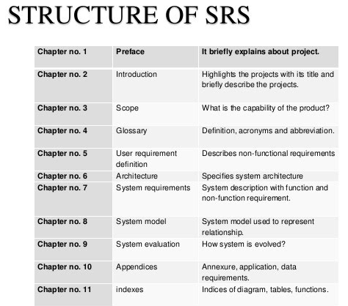

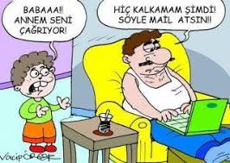
Requirement Phase
Notes:
Once all the information has been gathered , the next step is to clearly define and document the product requirements.
Q:What was the name of this document ? We already talked about
Software Requirements Specification Document. it is SRS.
SRS consists of all the necessary requirements to be designed and developed during the project life cycle.
You can think of SRS like a checklist. When the project is finished, what we have asked for, can be viewed here like a checklist.
Documentation is made after everything is clearly understood by both, customer and product manager.
there should be mutual understanding between both of them.
Regarding the Requirement phase, let's underline the following: this is the stage of determining exactly what the customer wants from us. So that, this is the most critical step in SDLC.
and lastly, At this stage, we should be in constant communication with the customer.

Slide 26
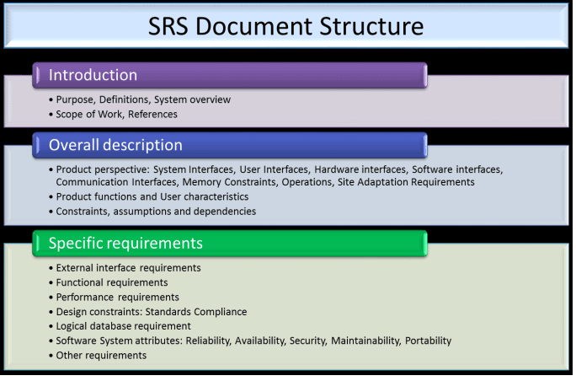

Requirement Phase
Notes:
In this slide you can see thr srs document structure.
Now I want to show you a sample SRS template AÇ

Slide 27
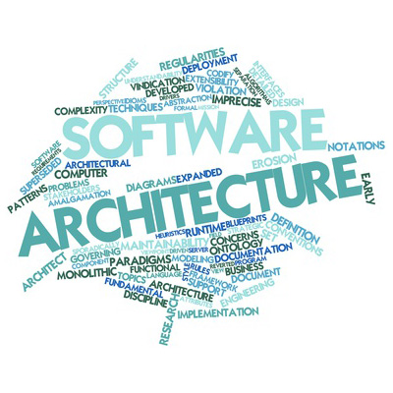
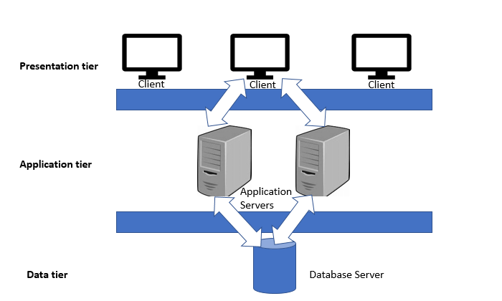
Design Phase
Requirement Analysis
Design
Build/
Development
Testing
Deploy
Deliver
Maintenance
Notes:
in the light of SRS document, the design stage starts and the software is created first in the mind at this stage.
One of the most important techniques used in software design is Abstraction.
You remember it from the Computional Thinking class.
Abstraction is the ignoring of some properties of objects, events and situations in order to facilitate the solution of problems.
Abstraction simplifies the problem, allowing us to focus on the most important parts of it. Logical, logical models are developed.
After that we have to make the physical design.
We say this application will does this and will does that but how will it does them. Here comes the physical design.
The logical design of the system is transformed into a physical design in this stage.
(Therefore, this stage is one of the high priority stages of SDLC.)
Decomposition-breaking something into smaller parts
Pattern Recognition-looking for similarities and trends
Abstraction-focusing on what’s important and ignoring what’s unnecessary.
Algorithm Design-Creation of step by step instructions to solve a problem.
Debugging- fixing your errors within the algorithm

Slide 28

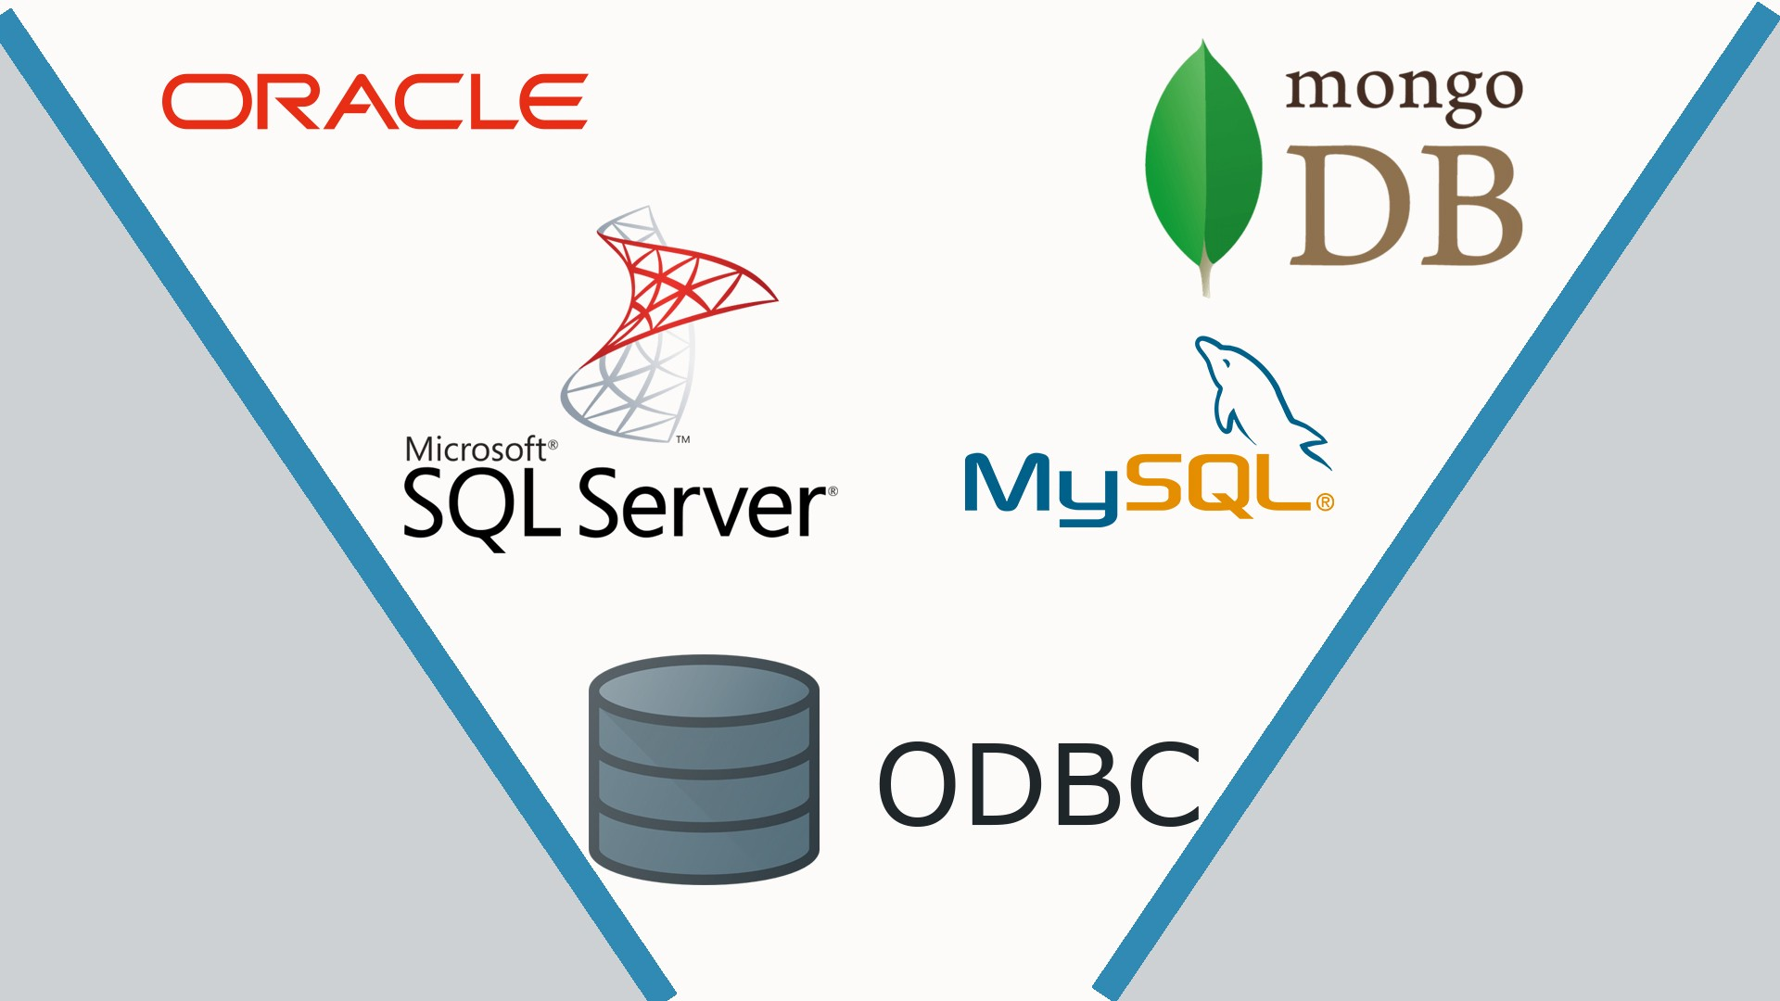
Design Phase
Requirement Analysis
Design
Build/
Development
Testing
Deploy
Deliver
Maintenance
Notes:
At this stage, we have to decide all needs such as;
which programming language the software will be coded in (Java, C ++, .NET, PHP, python ),
what type of database will be used (Oracle,Postgres, MySQL, NoSQL),
the environment for the smooth operation, running of the software, which will be the final output.
We have to decide this because in next stage the developers will begin coding according to this design.
If your design is bad your app will be bad even you coded it best way.

Slide 29
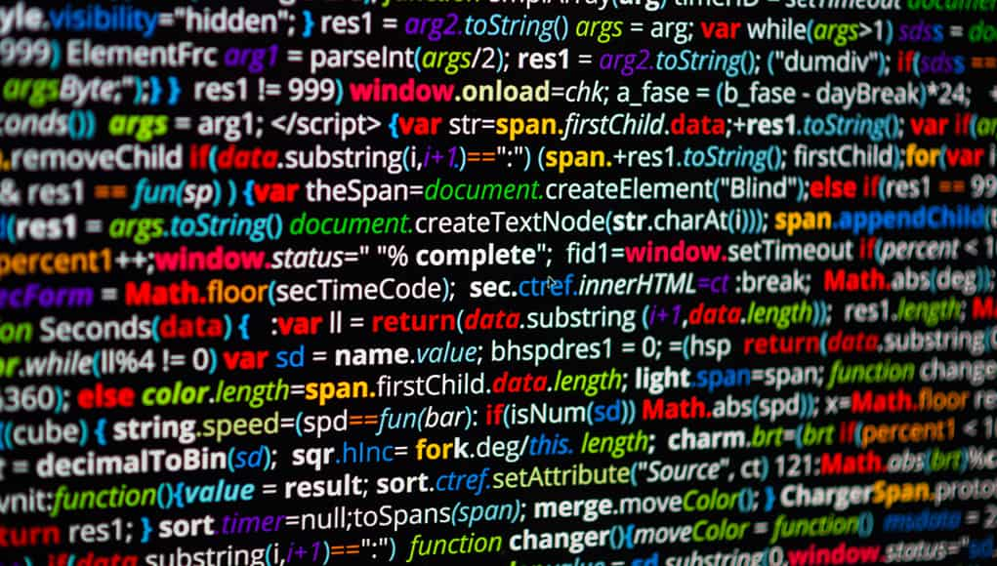
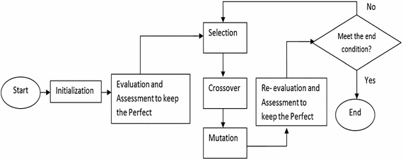
Build/Development Phase
Requirement Analysis
Design
Build/
Development
Testing
Deploy
Deliver
Maintenance
Notes:
The third phase of SDLC is the software development phase.
After the design is finished, this stage starts.
This phase is also called the coding phase.
This is the manufacturing stage of the software development.
The necessary algorithm development and coding are done at this stage.
The software development team starts to build the entire system using the programming language determined at the design phase.

Slide 30
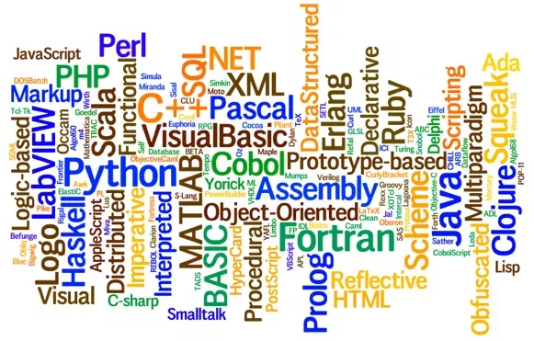
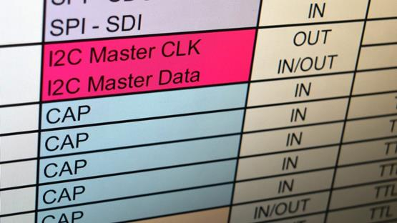
Build/Development Phase
Design Phase
Requirement Analysis
Design
Build/
Development
Testing
Deploy
Deliver
Maintenance
Notes:
The activities to be carried out at this step are divided into small parts, units and modules, coding is made in accordance with the customer requirements specified in the SRS.
The Tasks are divided into small units or modules.
Developers start to coding.
according to the design and SRS document of course.

Slide 31

Phases of SDLC
At what phase we focus on the investigation?
Notes:
Q In which of the SDLC stages do we focus on inspection? Please give your answers on Pear Deck.
A Testing phase. Why?
Because this is the stage before finalizing the product. Here, the software tests are performed and it is checked whether it works as it is expected.
🍐 This is a Pear Deck Multiple Choice Slide. Your current options are: A: Requirement phase, B: Testing phase, C: Maintenance phase,
🍐 To edit the type of question or choices, go back to the "Ask Students a Question" in the Pear Deck sidebar.

Slide 32
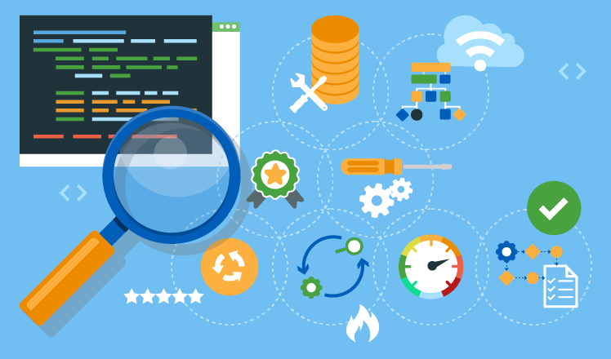
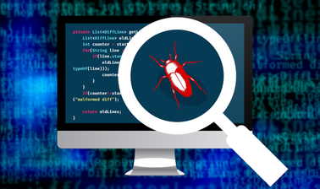
Testing Phase
Requirement Analysis
Design
Build/
Development
Testing
Deploy
Deliver
Maintenance
Notes:
Following the completion of the software, the testing phase begins.
At this stage, the focus is on monitoring the system and it is examined whether the expected outputs have been achieved according to user inputs.
Shortly; Testing phase,goes until the product reaches the quality standards defined in the SRS document,
https://www.atlassian.com/continuous-delivery/software-testing/types-of-software-testing
okuma
Focus on investigation and discovery
Make a test plan to start the test

Slide 33


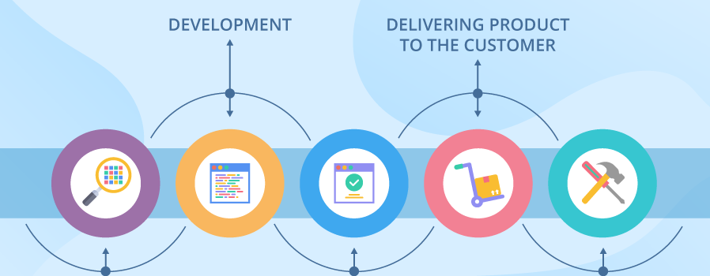
Requirement Analysis
Design
Build/
Development
Testing
Deploy
Deliver
Maintenance
Notes:
When the software tests are completed with a satisfactory as determined in the test plan,
and if there is no problem in the operation of the software, the product is delivered to the customer.
This delivery activity or the installation of the product in customer systems is called deployment.
But before the delivery it is recommended that to do beta tests first.
Beta testing is a type of user and usability testing, in which the product team gives a nearly finished product to a group of people who represent the target audience.
The group performs regular tasks in their natural environment and then evaluates the product experience.
The goal of beta testing is to uncover any issues with the user experience so that the product team can address them before releasing the product
In beta testing, customers may request changes not included in the software but specified in the requirement document such as a more user-friendly interface.
However, these change requests must be within the limits set by the SRS, big changes or radical change requests may not be accepted.

Slide 34
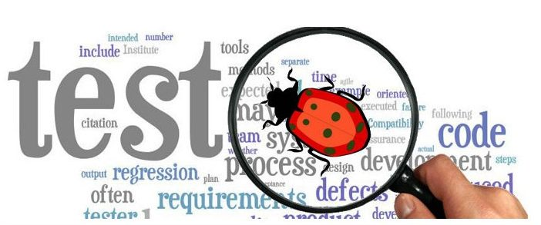
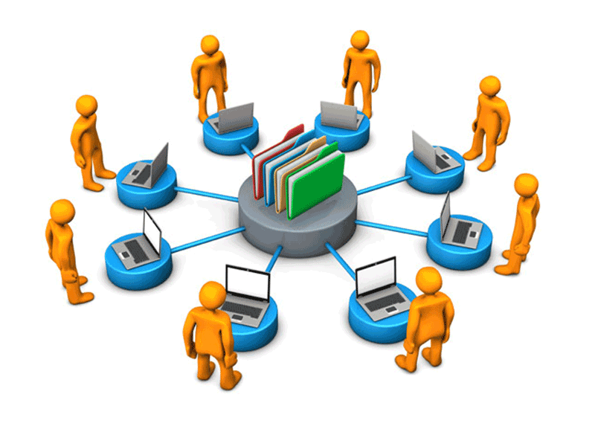
Requirement Analysis
Design
Build/
Development
Testing
Deploy
Deliver
Maintenance
Notes:
However, there is one more action to be taken before the product is delivered.
User acceptance test (UAT),
It is one of the last and most important project stages that must be done before the newly developed software / product is launched on the market.
Therefore, we can call UAT the last exit before the bridge for software.
Usually the end user who will use the application in the cusomers company do the tests. (Related business unit).
For example, you have prepared a customer management program for the needs of a company.
those who will use the software are allowed to do the test.
Testing should be done in an environment similar to production environment.
When it is seen that the requirements are met, the delivery process starts with the approval of the end user.
In addition, if a customer using the software encounters any defects or bugs, the development team is informed about the issue to resolve the problem.
If the encountered error is critical, the development team will solve this error as soon as possible.
After all errors and bugs are eliminated and changes are completed, the final software is delivered to the end user.
(However, if it is a simple bug that is not critical and does not directly affect the operation of the system, this will be fixed in the next release.)

Slide 35
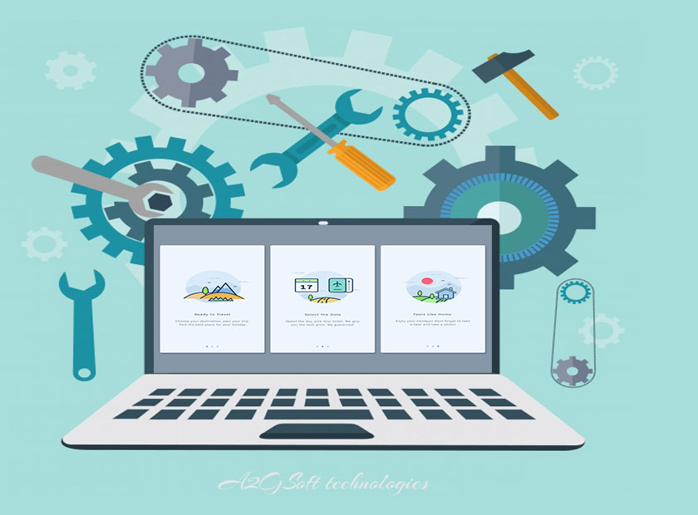
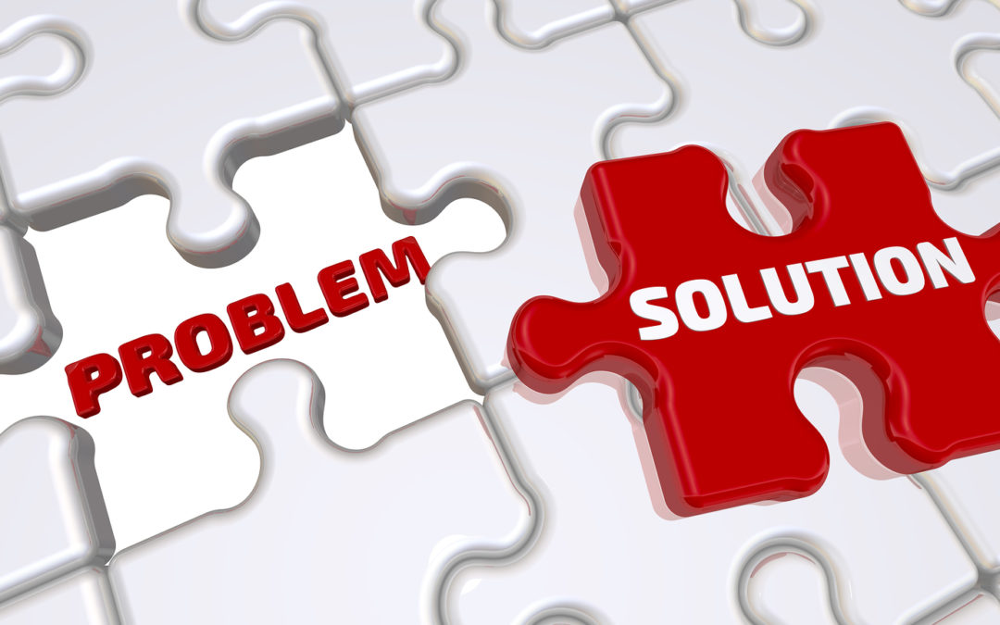
Requirement Analysis
Design
Build/
Development
Testing
Deploy
Deliver
Maintenance
Notes:
The last phase of SDLC is the maintenance phase.
After all test stages are completed, and the delivery stage is carried out this stage starts.

Slide 36
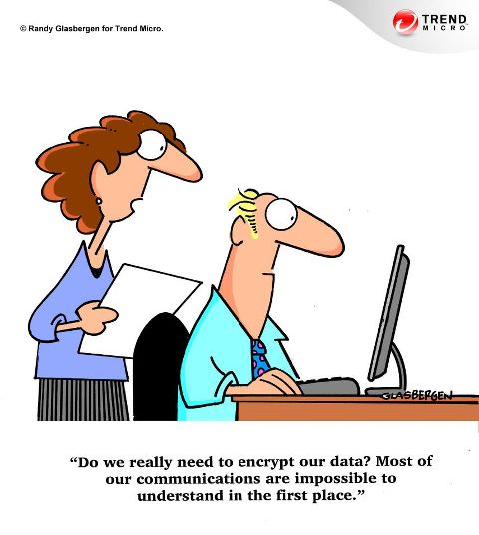
Requirement Analysis
Feasibility Study
Design
Coding
Testing
Install
Deploy
Maintenance
Verilerimizi gerçekten şifrelemek zorunda mıyız? Zaten başlangıçta iletişimimizin büyük bölümünü anlamak mümkün değil ki...
Notes:
In this phase what we do?
In the maintenance phase, 3 activities may be done;
a. Bug fix: System-related errors may occur because some scenarios have not been tested.
b. Update: It may be necessary to update the application to the new version of the software.
c. Enhancement: New features can be added to existing software.
Remember the football manager example...

Slide 37
SDLC Models
Notes:
We talked about what SDLC is and its phases in detail, now I am gonna give you an overview about the SDLC models and their application in the industry.

Slide 38
SDLC Models
List the common SDLC models.
Notes:
SDLC models explains the types of activities carried out at every stage of a software development project
There are couple of SDLC models that currently take different approaches.
Before moving on to these, dear friends, let's answer the question on the slide, please.
Q What are the SDLC models?
🍐 This is a Pear Deck Text Slide
🍐 To edit the type of question, go back to the "Ask Students a Question" in the Pear Deck sidebar.

Slide 39
SDLC Models
Spiral Model
RAD Model
V-Model
Agile Model
DevOps Model
Iterative Model
Waterfall Model
Notes:
There are various software development life cycle models defined and designed which are followed during software development process.
Each model follows a Series of steps unique to its type,
in order to ensure success in process of software development.
Ok now you see on the screen that, the most important and popular SDLC models followed by the industry;
Waterfall Model
Iterative Model
Spiral Model
V-model
RAD Model
DevOps Model and
Agile Model
((Project management models or methodologies provide the framework to execute projects. A framework is something that tells you how often you will meet and discuss the progress, how you will document results, how you will communicate and so on.))

Slide 40
SDLC Models
Spiral Model
RAD Model
V-Model
Agile Model
DevOps Model
Iterative Model
Waterfall Model
Notes:
In our cohort, we will show the Waterfall model as the classical approach besides the Agile and Devops models as the modern approaches.
In order to give general information within the scope of ITF, Devops will be covered for 3 hours, while Agile will be 6 hours totally.

Slide 41
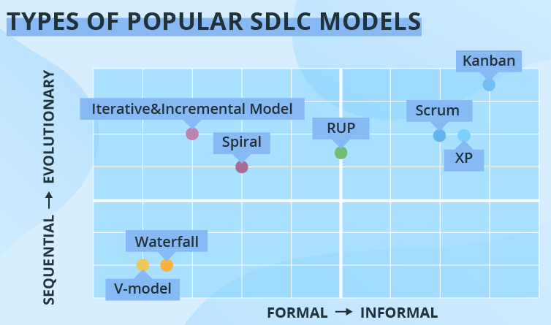
SDLC Models
Notes:
Friends! actually;
These models provide information to the people about what kind of stages will be followed in the development process,
which order or sequence will be followed,
and how the process will be implemented.
Separating the process into different models in this manner saves the project management from complexity and big crises
and provides convenience in terms of management and operation.
It eases the process.
There is a project in the middle and the project managers or the company itself determines what kind of project management model they will follow.
Recently, Today, it is seen that software companies generally use the Agile model and scrum or kanban methods in that.
You can also consider these methods under the umbrella of the Agile model.
Actully, I will not go further to the subject of methods for now, as you will see these issues in more detail in the future.
Stands for "Rational Unified Process." RUP is a software development process from Rational, a division of IBM. It divides the development process into four distinct phases that each involve business modeling, analysis and design, implementation, testing, and deployment. The main goal of RUP is to create high quality software with a predictable budget and time frame. Each of the life cycle phases can be repeated, if needed, until the main objectives are met. Once the transition stage is completed successfully, the project is finished.
Extreme Programming (XP) is an agile software development framework that aims to produce higher quality software, and higher quality for the development team. XP is the most specific of the agile frameworks regarding appropriate engineering practices for software development. Extreme Programming life cycle is the time required to perform a typical XP project. It begins at the stage of planning and ends when the final product is delivered to the customer. As we have already mentioned, XP is an Agile methodology. It means that it is based on the principle of iterative cycles
.

Slide 42

SDLC Models
Notes:
So the models emerged within the framework of the hardware and technologies of the time period they are related to.
Maybe 5 years later we will be talking about new models.
The size of the companies, their internal organization types,
the choice of horizontal and vertical hierarchy,
and of course the project itself, also affect the SDLC model to be used.

Slide 43
SDLC Models
Which one is the
traditional SDLC model?
Notes:
Q Which one is the traditional SDLC model?
🍐 This is a Pear Deck Multiple Choice Slide. Your current options are: A: Agile, B: DevOps, C: Waterfall, D: RAD, E: Spiral,
🍐 To edit the type of question or choices, go back to the "Ask Students a Question" in the Pear Deck sidebar.

Slide 44
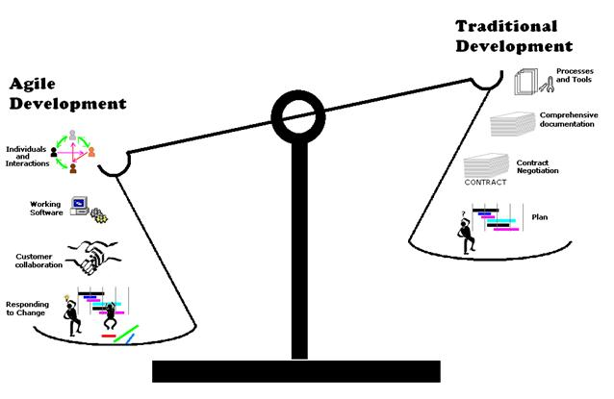
SDLC Models
Notes:
These models are divided into traditional and modern
In summary, while the models in which SDLC steps follow each other in order
are called conventional or traditional, like Waterfall model, V model
but The models in which the stages are carried out together are described as modern.
Another name given to modern models or methods is Agile. We will go into the detail of traditional and Agile comparison in the Agile lesson.
Why such a new need has arisen and where traditional methods are stucked , we will see all together later in Agile classes.

Slide 45
Waterfall Model
4
Notes:
we will examine today the waterfall model.
This is the earliest approach and a widely accepted SDLC model.
and accepted as classic model in software development in this field.
But before lests give a break

Slide 46

Waterfall
Model
Notes:
Waterfall is considered to be the oldest configured SDLC model.
It also has a fairly simple approach, very simple to understand and use.
The transition between the stages of the software development process is like spilling a waterfall, like a waterfall pouring.
In waterfall model phases do not overlap..
This is the main point of waterfall.
In waterfall model phases do not overlap..
You see, after one stage has completed then the next stage starts.

Slide 47
Waterfall Model
In which years did the Waterfall model appear?
Notes:
wakeup service
Q Waterwall modeli hangi yıllarda ortaya çıkmıştır.
1970
🍐 This is a Pear Deck Multiple Choice Slide. Your current options are: A: 1960, B: 1970, C: 1980, D: 1990, E: 2000,
🍐 To edit the type of question or choices, go back to the "Ask Students a Question" in the Pear Deck sidebar.
1970

Slide 48
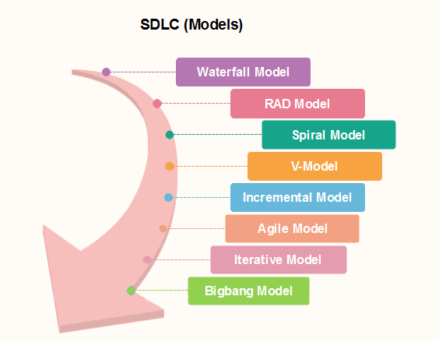
Waterfall Model
1970
Notes:
The Waterfall model emerged in the 1970s.

Slide 49
Waterfall
Model
Notes:
The basic steps in the production process are carried out at least once from start to finish.
It is a very suitable model for projects whose requirements are well defined and documented. So It is used in projects where the requirements are predetermined and the change will be very little.
It predicts that documentation should be found and done at every stage of production rather than a process stage, so we can say that it is somewhat document driven.
Not every stage can start before the previous stage is completed. So there is no overlap between stages.

Slide 50
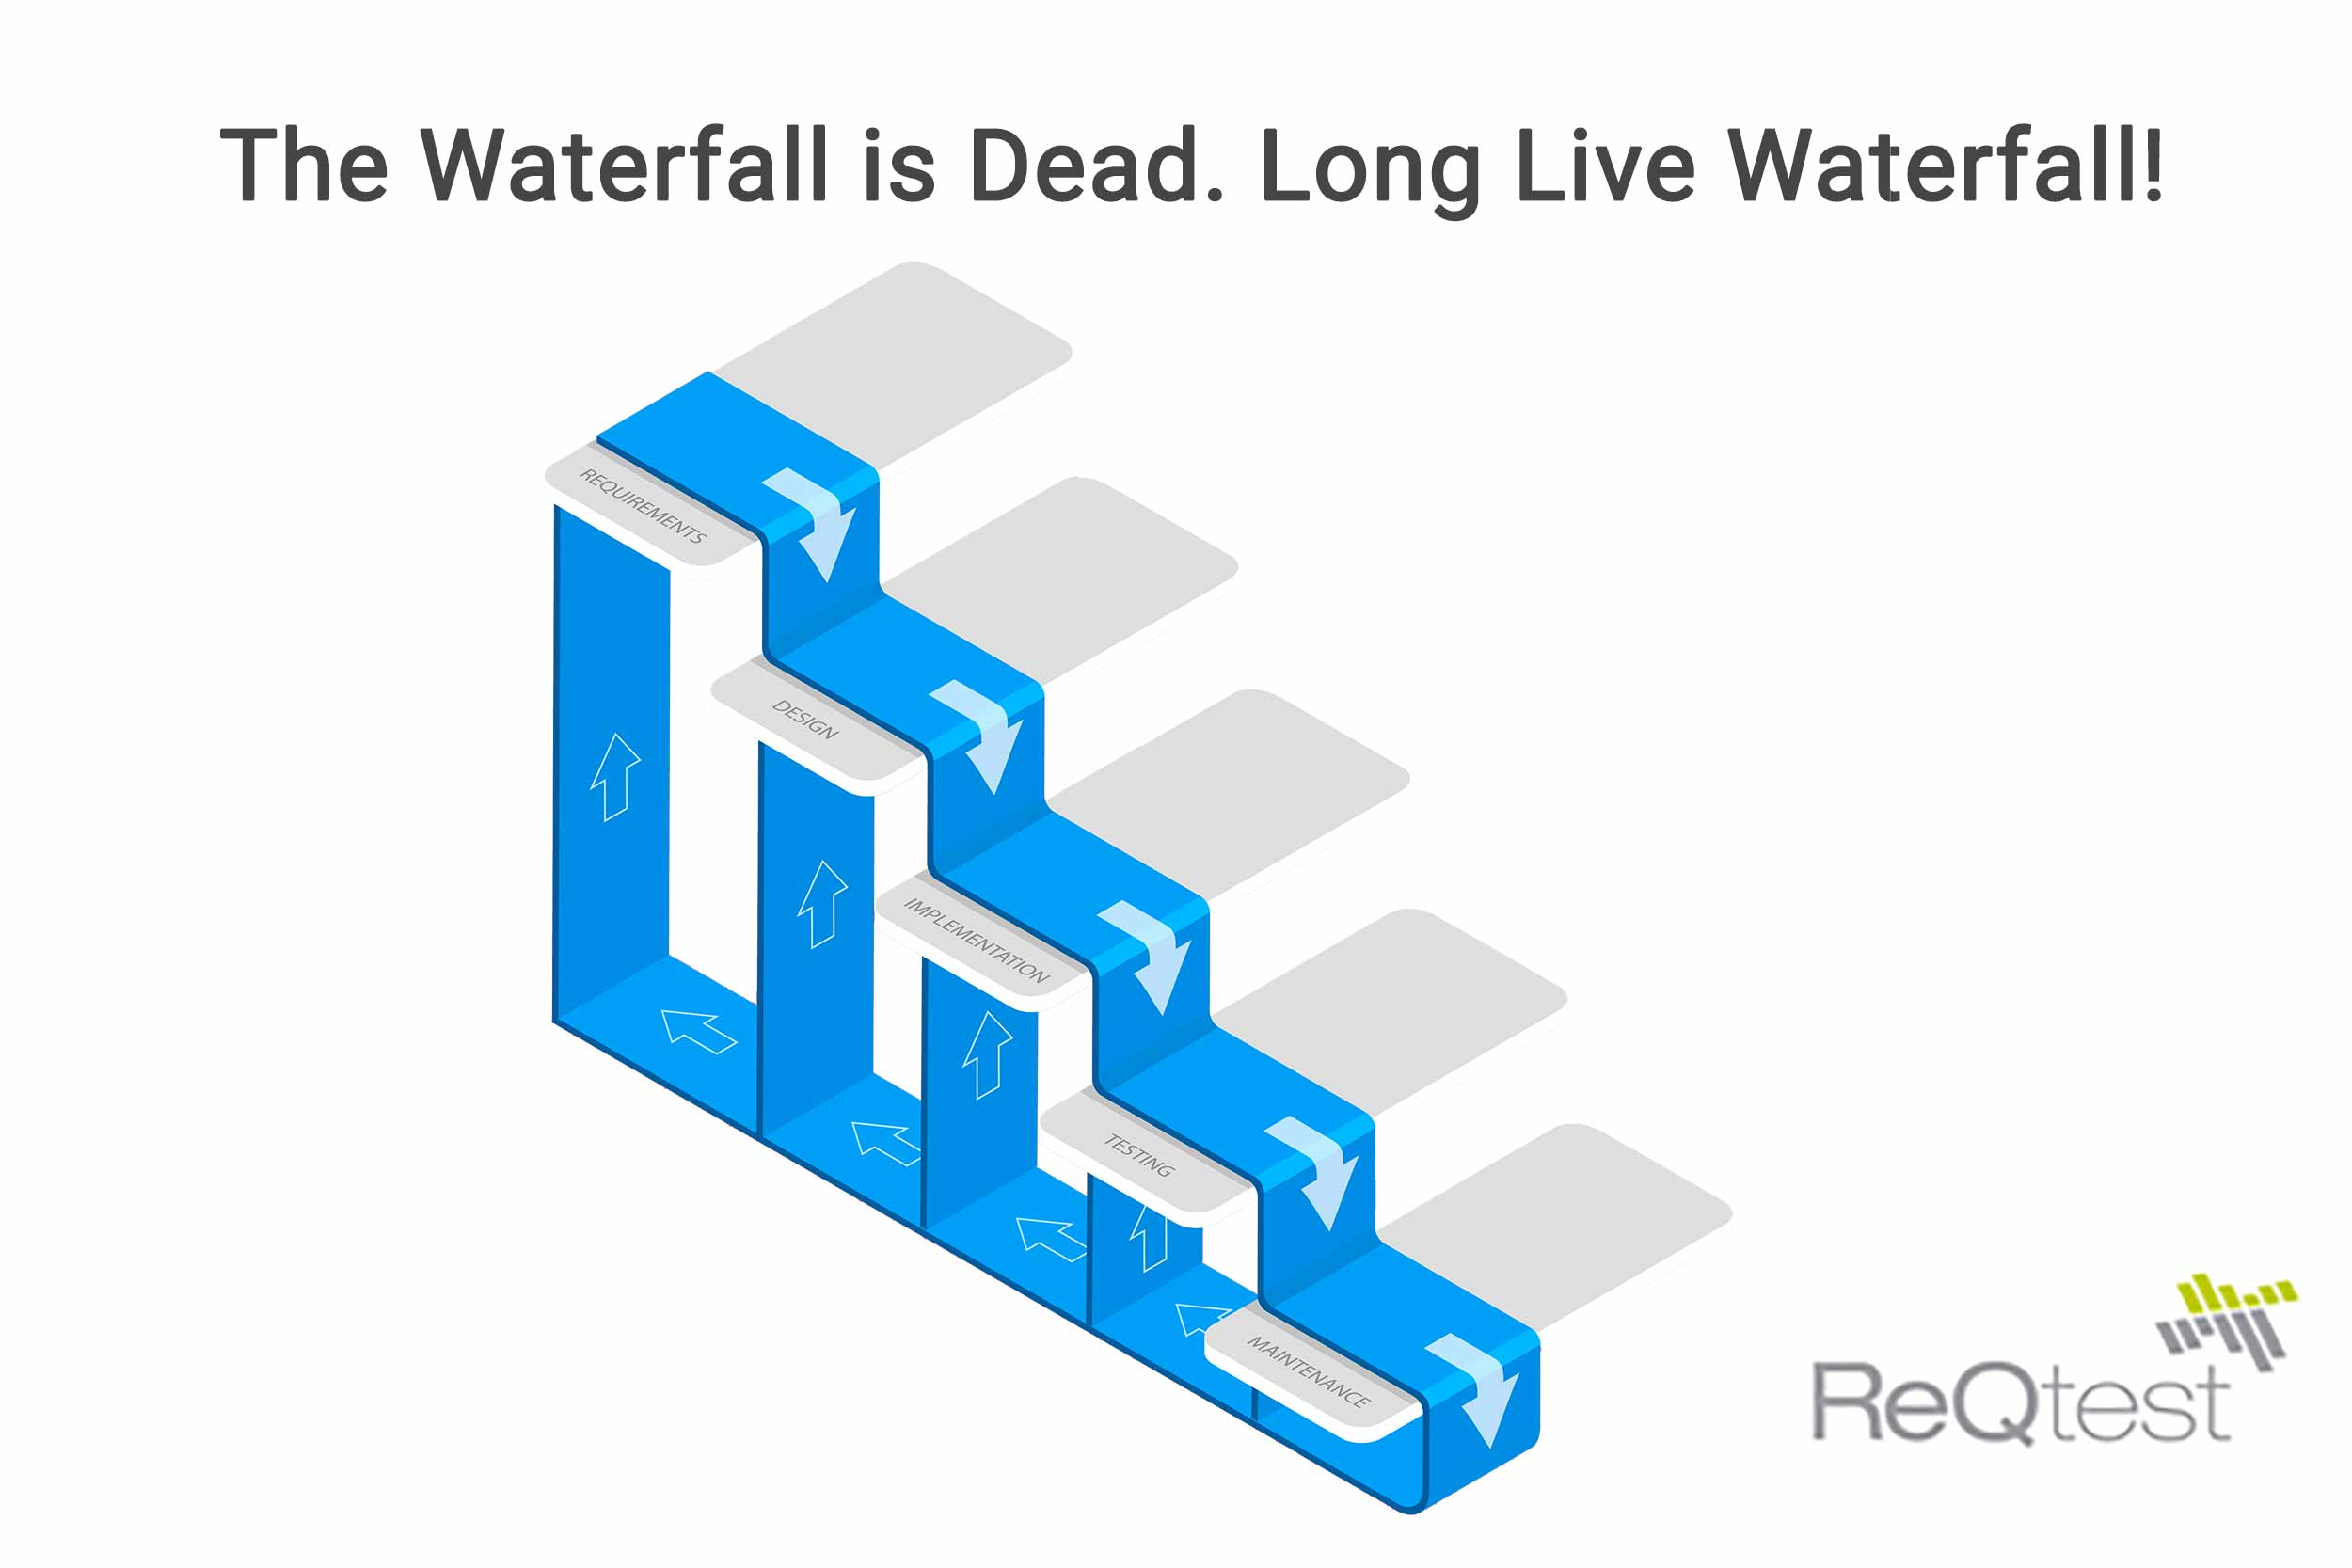
Waterfall Model
Notes:
Yes, as I have stated, the waterfall model is the oldest approach and has been widely accepted. so where did this model come from
Originally it was used in the manufacturing and construction industries,
when the model was adapted for software development for the first time, there was no alternative.
In the beginning, it was used to complete some software projects successfully.
since it is easy to understand and usage of the model is very simple.
In parallel with the progress in computer technology, it started to be used in the software development process of that period.
This method can be considered sufficient for that period.(40-50 years ago ..)

Slide 51
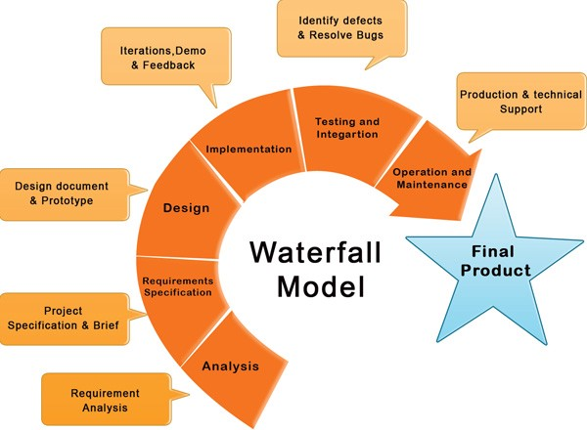
Waterfall
Model
SRS
Notes:
Let's briefly summarize the successive phases of the Waterfall model:
Requirements specification and analysis - During this process, all possible system requirements to be created are collected and a very comprehensive SRS document is prepared.
Since no innovations and changes can be made in the process, during the process the requests should be clearly stated at this stage.
The output of this phase is the SRS document that will be used in the next phase.
(Return back to SRS slides…31 )

Slide 52
Waterfall
Model
SDD
Notes:
In the System Design phase, where the system requirements compiled in the first stage are reviewed,
a picture of the entire system is revealed.
In this stage, hardware and system properties are determined and general system architecture is defined.
Which software language will be used and which platforms will be chosen are determined on the basis of the SRS document.
The output of this stage is Software Design Document SDD - (Software Design Document)

Slide 53
Waterfall Model
Coding is the other name for implementation/developing in SDLC.
Notes:
wakeup service
Q is that correct?
yes
🍐 This is a Pear Deck Multiple Choice Slide. Your current options are: A: True, B: False,
🍐 To edit the type of question or choices, go back to the "Ask Students a Question" in the Pear Deck sidebar.

Slide 54
Waterfall
Model
Notes:
In the Implementation phase, the inputs from the design phase are divided into modules to be integrated later and coded.
here, the system is first developed in
small programs called units, which are integrated in the next phase. Each unit is developed and tested for its functionality which is referred to as Unit Testing.

Slide 55
Waterfall
Model
Notes:
Any flaws and deficiencies are checked for the next stage in the integration and testing of the whole system.
If there are bugs,errors any fails in the system, incompatibility or conflicts between modules, they are fixed and the software leaves the development process and becomes production.

Slide 56
Waterfall
Model
Notes:
Once the functional and non functional testing is done I mean after the all tests are completed, the final product is installed in the customer environment or released to the market.

Slide 57
Waterfall
Model
Notes:
However, the process has not yet ended with the delivery of the software to the customer.
Following the delivery, unforeseen problems may arise in the environments where the software is running.

Slide 58
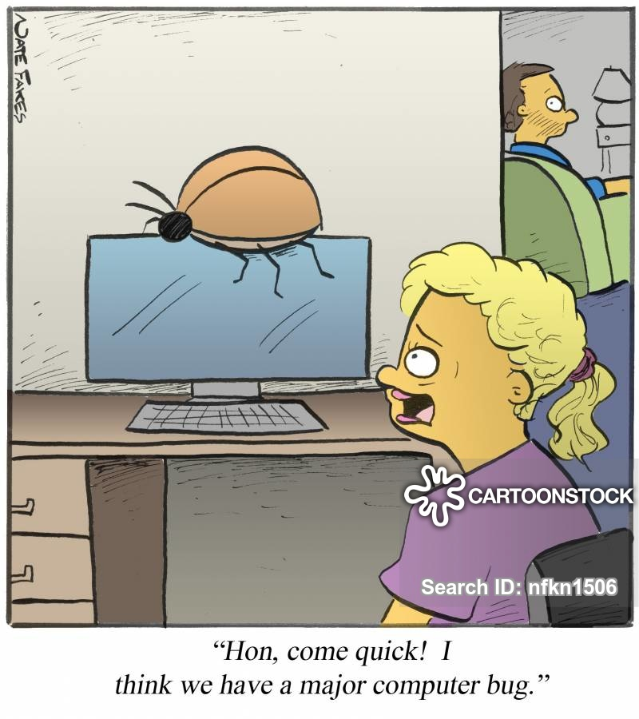
Waterfall
Model
Hayatım, çabuk geeelll!
Sanırım büyük bir bug’ımız var.
Notes:
To fix these problems, patches are made and integrated into the system.
Also at this stage, additional versions can be published to improve the product.
Such improvements and enhancements are carried out in the customer environment.

Slide 59
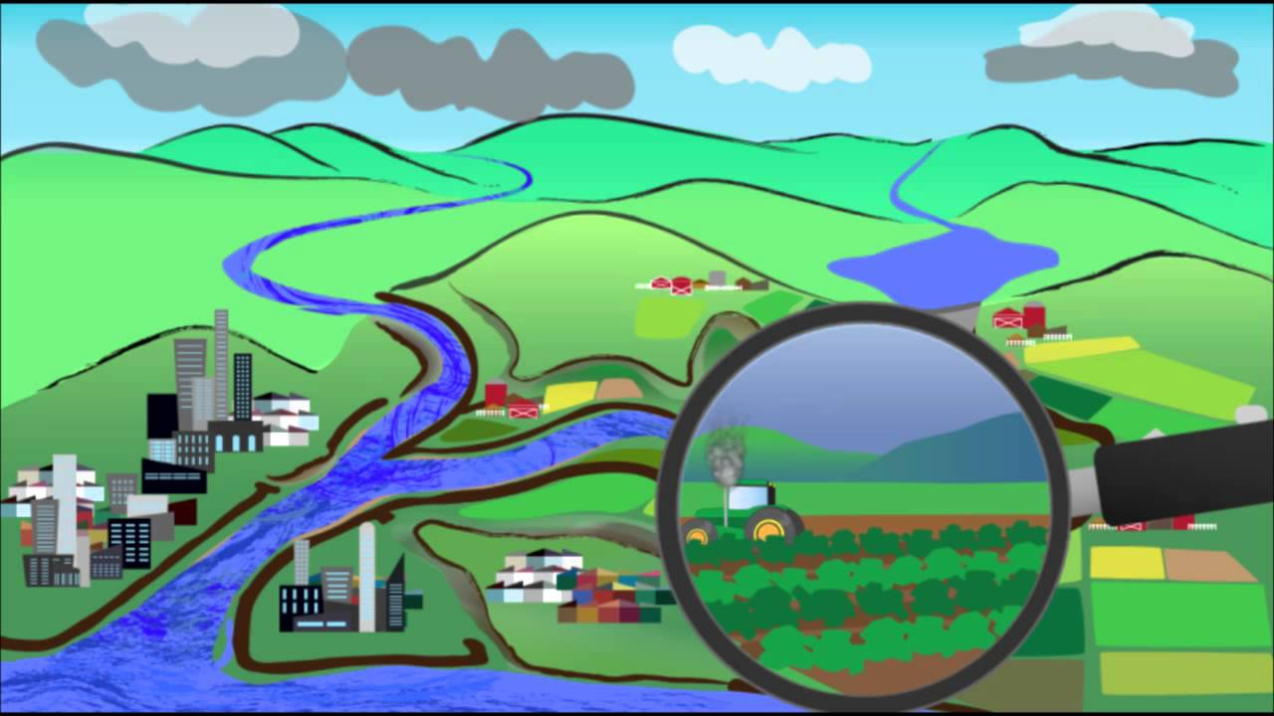
Application of the Waterfall Model
Notes:
Every developed software is different and needs an suitable SDLC approach.
So where the Waterfall model can be used effectively.
If the Requirements are very well documented,
clear and fixed you can use waterfall
In cases where there are no ambiguous requirements,
and when the projects are generally short

Slide 60
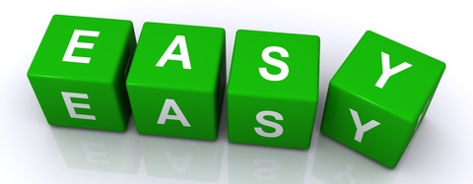

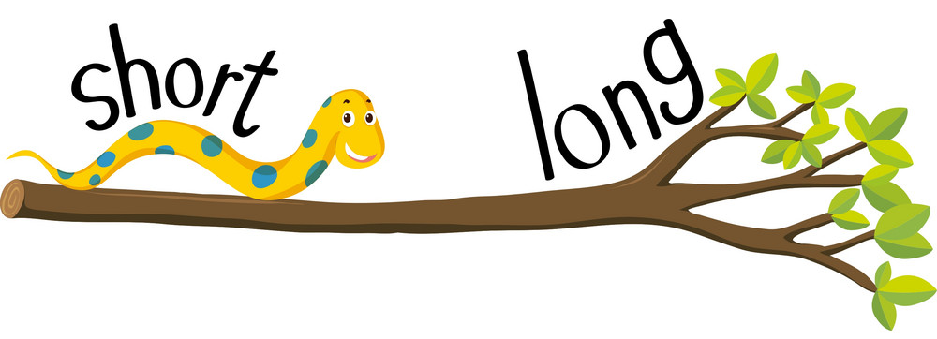
Waterfall Model
Advantages
Notes:
Now I want to mention the advantages of the Waterfall Model:
Lets make it simple
Easy and simple to use and understand.
Easy to manage
Phases clearly defined.

Slide 61
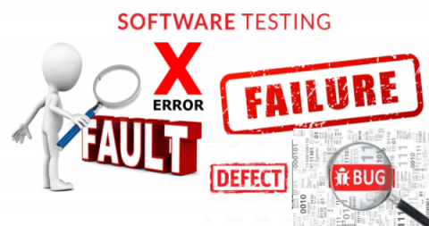
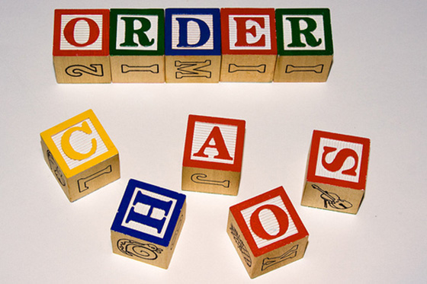
Waterfall Model
Advantages
Notes:
It is easy and simple to use and understand.
Model management is easy. For each phase there is a specific output and a review process.
The phases are executed and completed sequentially (one by one).
It is more suitable for small projects where the requirements are well understood.
All stages are clearly defined
The process and results are well documented.
A deadline can be established for each stage, and the product can progress step-by-step through the stages of the development process model.
Yep, these are the advantages of SDLC

Slide 62



Waterfall Model
disadvantages
Notes:
What about the disadvantages ;
The loss of time due to errors that may occur in the upper phases is high.
It is not suitable for projects where requirements are likely to change.
The customer sees the product at the end so there is a risk that the software can be refused.
so this means There is a high amount of risk and uncertainty.
Lets make them simple again
the upper phase errors is quite high.
No working software is produced until late during the life cycle.
There is a high amount of risk and uncertainty.

Slide 63


Waterfall Model
disadvantages
Notes:
Q: What do you think is waterfall a bad model - not suitable for software developing? Not suitable for today?
I don’t think it is a bad model. And it can be still usefull today. This is my opinion; agile is for customer satisfaction.
and it is very successful to prevent customer rejection of the product at the end of the project.
but if you don’t have a customer to be satisfied, you can use waterfall.
For example US army had used waterfall until 1990’ and then a modified waterfall model to meet the new needs.
NASA is still using waterfall with an incremented way. Every phase is checked and reviewed we can say implemented twice.
Canadian’ railways needed a big railway traffic software in 2001. And they used waterfall model for this project because the needs were not changing and documentation was perfect.
Q: What about SpaceX ? what do you think which Model Spacex is using?
agile

Slide 64
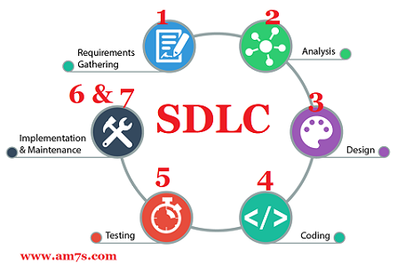
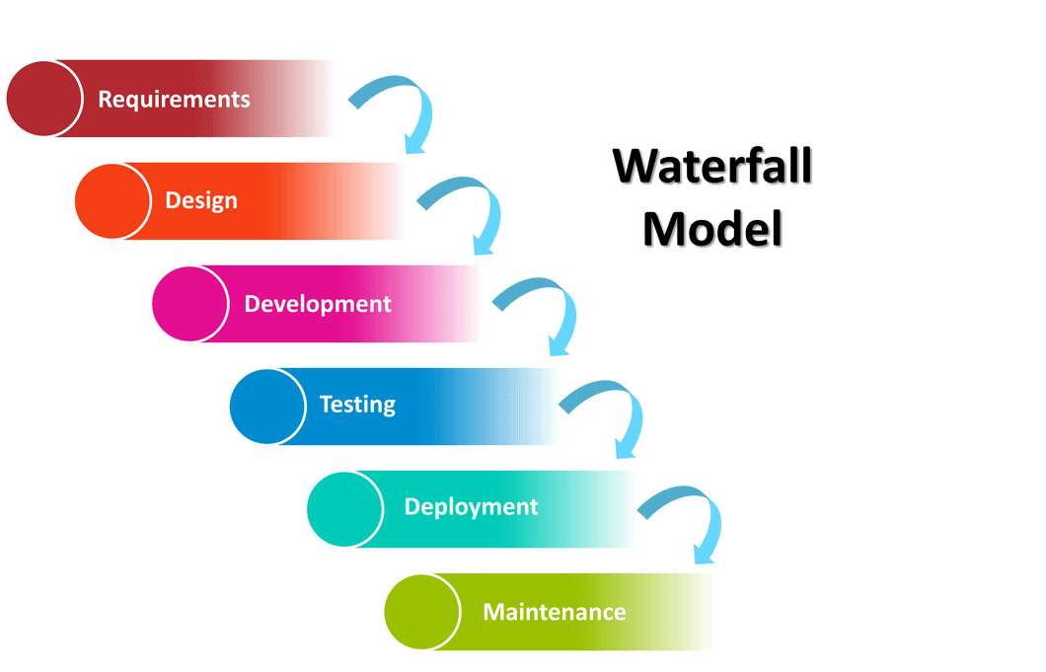
Summary
Notes:
This is the end of our topics today. Lets summarize todays topic with a short video.
This is my own video, prepared it for SDLC, hope it will help you to understand the SDLC.
so If we summarize the Waterfall model briefly.
This model is the first project management model used in software development projects.
Despite its shortcomings, the software development discipline has emerged with this model and is still usable despite its 50-year history.

Slide 65

Notes:
Yes, after this intense information bombardment,
let's get ourselves a little bit with a kahoot.
Rapid Application Development (RAD) is a form of agile software development methodology that prioritizes rapid prototype releases and iterations. Unlike the Waterfall method, RAD emphasizes the use of software and user feedback over strict planning and requirements recording

Slide 66
THANKS!
Any questions?

Slide 67
Iterative Model
4

Slide 68
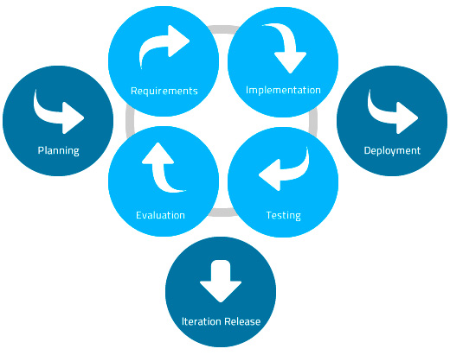
Iterative Model
Notes:
In Iterative model, iterative process starts with a simple implementation of a small set of the software requirements and iteratively enhances the evolving versions until the complete
system is implemented and ready to be deployed.

Slide 69
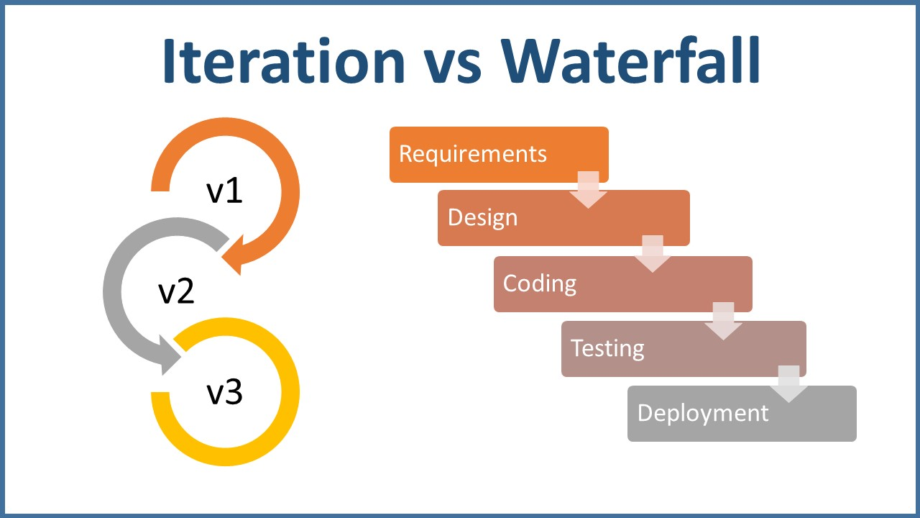
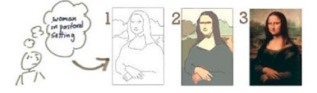
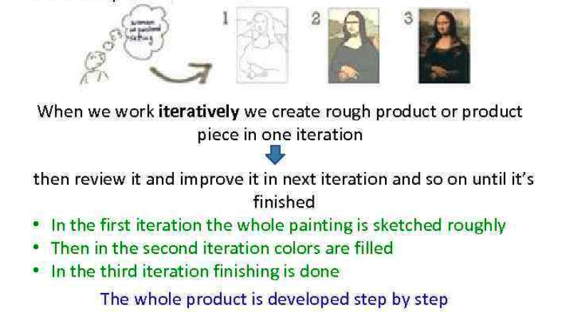
Iterative Model
Notes:
An iterative life cycle model does not attempt to start with a full specification of requirements. Instead, development begins by specifying and implementing just part of the software, in order to identify further requirements.
This process is then repeated, producing a new version of the software at the end of each iteration of the model.
At each iteration, design modifications are made and new functional
capabilities are added. The basic idea behind this method is to develop a system through repeated cycles (iterative) and in smaller portions at a time (incremental).
Each subsequent release of the module adds function
to the previous release. The process continues till the complete system is ready as per the requirement.
Mona Lisa Painting by Leonardo da Vinci
Description The Mona Lisa is a half-length portrait painting by Italian artist Leonardo da Vinci. Considered an archetypal masterpiece of the Italian Renaissance, it has been described as "the best known, the most visited, the most written about, the most sung about in 1500 years

Slide 70


Iterative Model
Notes:
Like other SDLC models, Iterative and incremental development has some specific applications in the software industry. This model is most often used in the following scenarios:
Requirements of the complete system are clearly defined and understood.
Major requirements must be defined; however, some functionalities or requested enhancements may evolve with time.
A new technology is being used and is being learnt by the development team while working on the project.
There are some high risk features and goals which may change in the future.

Slide 71




Iterative Model
advantages
Notes:
The advantage of this model is that there is a working model of the system at a very early stage of development which makes it easier to find functional or design flaws.
Finding issues at an early stage of development enables to take corrective measures in a limited budget.

Slide 72



Iterative Model
disadvantages
Notes:
The disadvantage with this SDLC model is that it is applicable only to large and bulky software development projects. This is because it is hard to break a small software system into further small serviceable increments/modules.

Slide 73

Iterative
Model
Notes:
As you can see, although it varies according to the needs, risk management and, accordingly, the cost seems low at the beginning, but it is not easily adaptable to changing situations and is not suitable especially for small projects.

Slide 74
Spiral Model
4

Slide 75

Spiral Model
Notes:
Spiral model is a combination of iterative development process model and sequential linear development model like waterfall model with very high emphasis on risk analysis.
It allows for incremental releases of the product, or incremental refinement through each iteration around the spiral.

Slide 76


Spiral Model
Notes:
Spiral Model is widely used in the software industry as it is in synch with the natural development process of any product for example learning with maturity and also involves minimum risk for the customer as well as the development firms. So where this model can be used ;
When there is a budget constraint and risk evaluation is important
For medium to high-risk projects
Long-term project commitment because of potential changes to economic priorities as the requirements change with time
Customer is not sure of their requirements which is usually the case
Requirements are complex and need evaluation to get clarity
New product line which should be released in phases to get enough customer feedback
Significant changes are expected in the product during the development cycle

Slide 77

Spiral Model

Slide 78
V - Model
4

Slide 79

V - Model
Notes:
The V- model is SDLC model where execution of processes happens in a sequential manner in V-shape. It is also known as Verification and Validation model.
V-Model is an extension of the waterfall model and is based on association of a testing phase for each corresponding development stage. This means that for every single phase in the development cycle there is a directly associated testing phase. This is a highly disciplined model and next phase starts only after completion of the previous phase.
Under V-Model, the corresponding testing phase of the development phase is planned in parallel. So there are Verification phases on one side of the ‘V’ and Validation phases on the other side. Coding phase joins the two sides of the V-Model.

Slide 80

V - Model
Notes:
V- Model application is almost same as waterfall model, as both the models are of sequential type. Requirements have to be very clear before the project starts, because it is usually expensive to go back and make changes. This model is used in the medical development field mostly, as it is strictly disciplined domain.
where can we use the V-Model:
Requirements are well defined, clearly documented and fixed.
Product definition is stable.
Technology is not dynamic and is well understood by the project team.
There are no ambiguous or undefined requirements
The project is short.

Slide 81

V - Model
advantages
Notes:
The advantage of V-Model is that it’s very easy to understand and apply. The simplicity of this model also makes it easier to manage.

Slide 82


V - Model
disadvantages
Notes:
The disadvantage is that the model is not flexible to changes and just in case there is a requirement change, which is very common in today’s dynamic world, it becomes very expensive to make the change.

Slide 83


V - Model

Slide 84
RAD Model
4

Slide 85

RAD Model
Notes:
The RAD (Rapid Application Development) model is based on prototyping and iterative development with no specific planning involved.
The process of writing the software itself involves the planning required for developing the product.
Rapid Application development focuses on gathering customer requirements through workshops or focus groups, early testing of the prototypes by the customer using iterative concept, reuse of the existing prototypes, continuous integration and rapid delivery.

Slide 86

RAD Model
Notes:
as I said, Rapid application development (RAD) is a software development methodology that uses minimal planning in favor of rapid prototyping.
Since there is no detailed preplanning, it makes it easier to incorporate the changes within the development process.
RAD projects follow iterative and incremental model and have small teams comprising of developers, domain experts, customer representatives and other IT resources working progressively on their component or prototype. The most important aspect for this model to be successful is to make sure that the prototypes developed are reusable.
Rapid Application Development (RAD) is a form of agile software development methodology that prioritizes rapid prototype releases and iterations. Unlike the Waterfall method, RAD emphasizes the use of software and user feedback over strict planning and requirements recording

Slide 87


RAD Model
Notes:
The traditional SDLC follows a rigid process models with high emphasis on requirement analysis and gathering before the coding starts. It puts a pressure on the customer to sign off the requirements before the project starts and the customer doesn’t get the feel of the product as there is no working build available for a long time.
The customer may need some changes after he actually gets to see the software, however the change process is quite rigid and it may not be feasible to incorporate major changes in the product in traditional SDLC.
RAD model focuses on iterative and incremental delivery of working models to the customer. This results in rapid delivery to the customer and customer involvement during the complete development cycle of product reducing the risk of non conformance with the actual user requirements.

Slide 88

RAD Model
Notes:
RAD model enables rapid delivery as it reduces the overall development time due to reusability of the components and parallel development.
RAD works well only if high skilled engineers are available and the customer is also committed to achieve the targeted prototype in the given time frame.
If there is commitment lacking on either side the model may fail.

Slide 89


RAD Model

Slide 90
Agile Model

Slide 91


Agile Model
Each iteration lasts from 1 - 3 weeks
Notes:
Agile SDLC model is a combination of iterative and incremental
process models with focus on process adaptability and customer
satisfaction by rapid delivery of working software product.
Agile Methods break the product into small incremental builds. These builds are provided in iterations. Each iteration typically lasts from about one to three weeks. Every iteration involves cross functional teams working simultaneously on various areas like planning, requirements analysis, design, coding, unit testing, and acceptance testing. At the end of the iteration a working product is displayed to the customer and important stakeholders.

Slide 92

Agile Model
Notes:
What is Agile?
Agile model believes that every project needs to be handled differently and the existing methods need to be tailored to best suit the project requirements. In agile the tasks are divided to time boxes (small time frames) to deliver specific features for a release.
Iterative approach is taken and working software build is delivered after each iteration. Each build is incremental in terms of features; the final build holds all the features required by the customer.
Agile thought process had started early in the software development and started becoming popular with time due to its flexibility and adaptability.

Slide 93

Agile Vs Traditional SDLC Models
Notes:
Agile is based on the adaptive software development methods where as the traditional SDLC models like waterfall model is based on predictive approach.
Predictive teams in the traditional SDLC models usually work with detailed planning and have a complete forecast of the exact tasks and features to be delivered in the next few months or during the product life cycle. Predictive methods entirely depend on the requirement analysis and planning done in the beginning of cycle. Any changes to be incorporated go through a strict change control management and prioritization.
On the other hand; Agile uses adaptive approach where there is no detailed planning and there is clarity on future tasks only in respect of what features need to be developed. There is feature driven development and the team adapts to the changing product requirements dynamically. The product is tested very frequently, through the release iterations, minimizing the risk of any major failures in future.

Slide 94


Agile Vs Traditional SDLC Models
Notes:
Customer interaction is the backbone of Agile methodology, and open communication with minimum documentation are the typical features of Agile development environment.
The agile teams work in close collaboration with each other and preferably are most often located in the same geographical location.
Agile methods are being widely accepted in the software world recently, however, this method may not always be suitable for all products. Of course there are some pros and cons of the agile model.
There are some project management tools as methots in Agile Model like Scrum, Kanban etc.
But I will not go in deep, since you are gonna see in detail soon.

Slide 95
THANKS!
Any questions?

